Slide 1
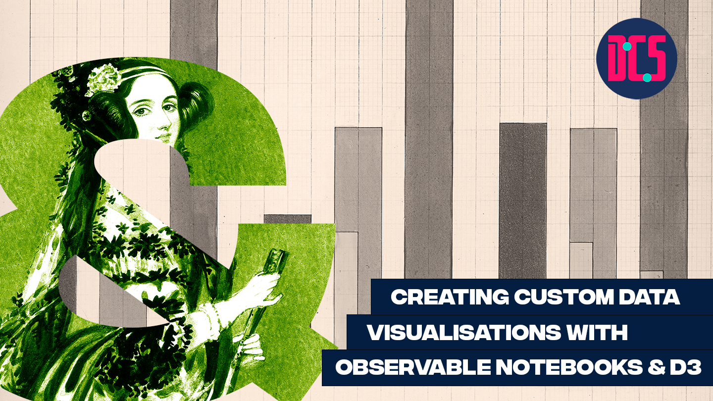
Notes:
- standard way of thinking about visualization: chart types
- Sometimes not quite enough:
- More eye catching
- Need to encode lots of data
- Will require training
- Show examples of custom visualizations (Stefanie posavec, Giorgia lupi, Federica fragapane, nadieh Bremer, Shirley wu, ...? + find examples of analytics focused applications with custom viz) warming stripes
- Introduce visual variables as alternative way of thinking about visualizations
- explain visual variables for a bar chart / line chart etc., then for more complex (custom) visualizations
DATA: Plastic Waste (Chris)
DATA: Own or Own Word in Data
https://ourworldindata.org/

Slide 2

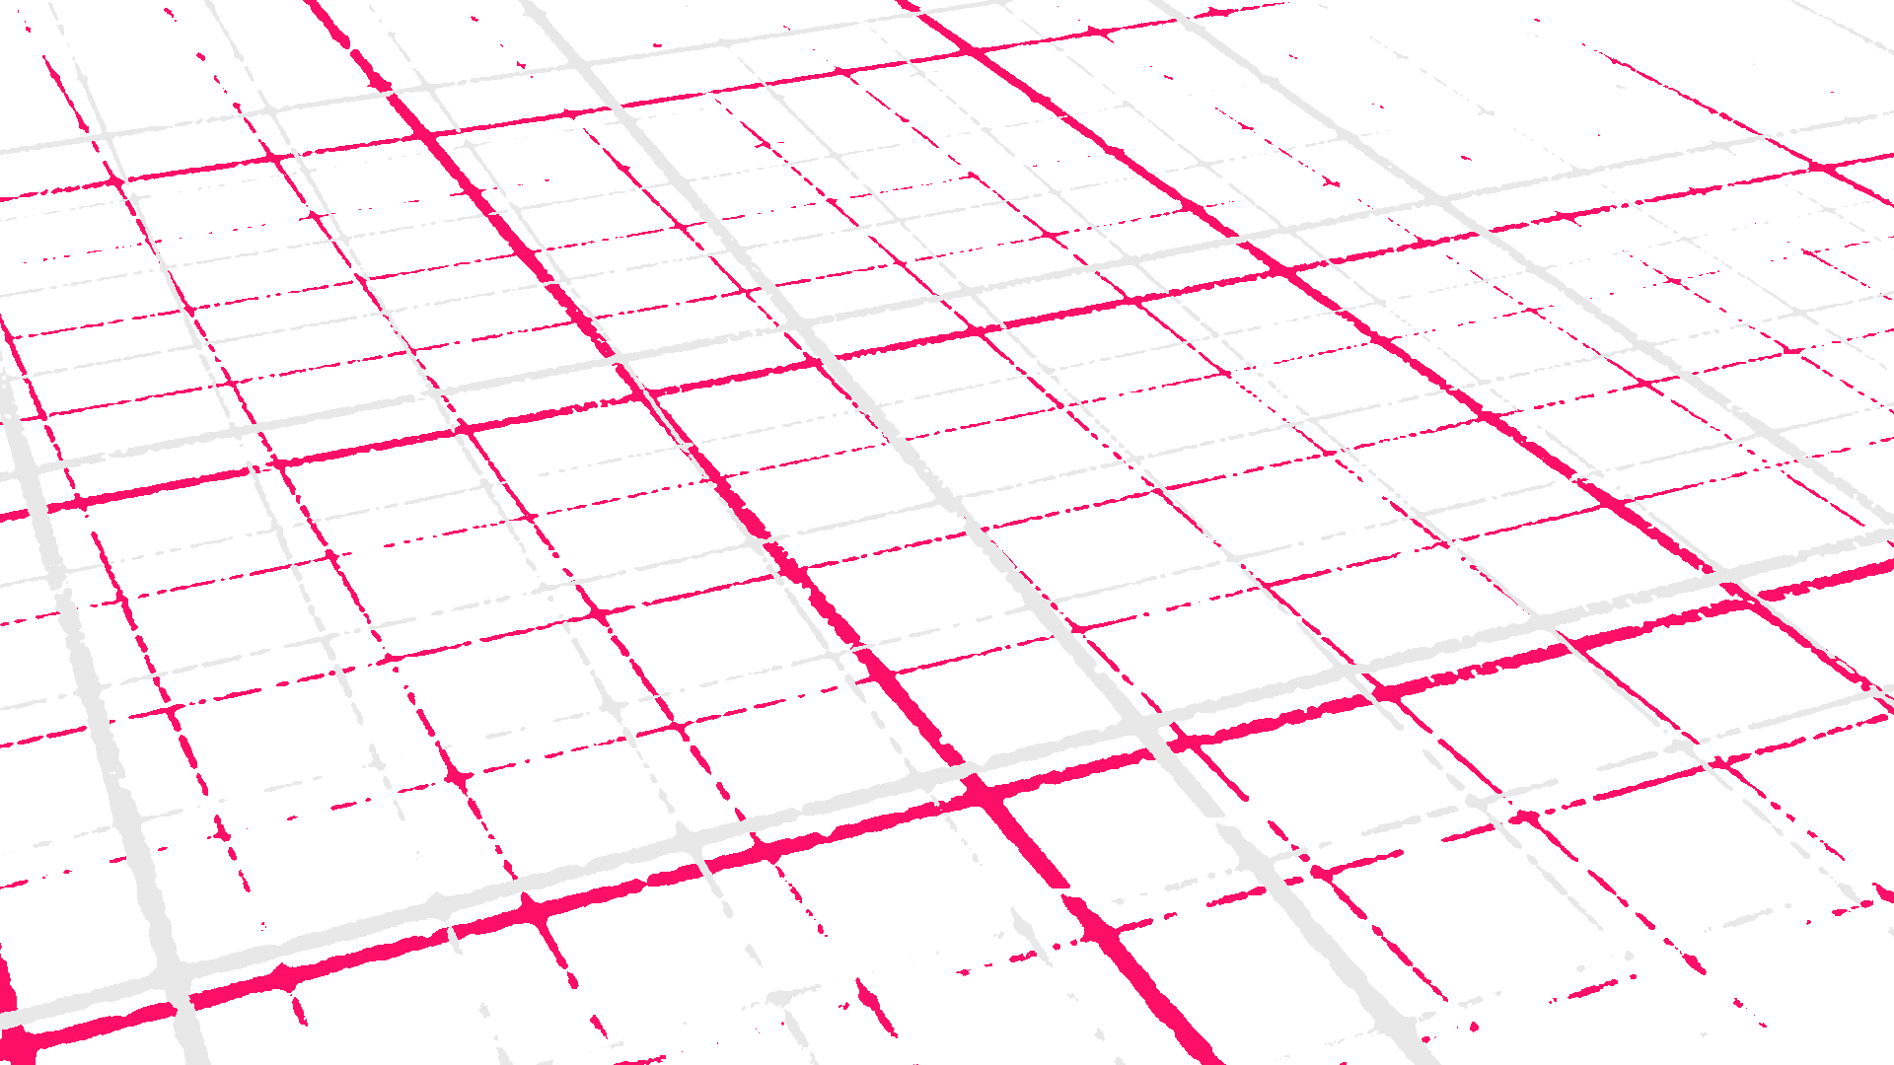

@EdCDCS
For all events, news, and support: cdcs.ed.ac.uk

Slide 3




Welcome
Chris Oldnall
Sarah Schöttler
www.cdcs.ed.ac.uk
Notes:
Participants to do a round of introductions

Slide 4
Schedule for Session 1
Find these slides online:
github.com/DCS-training/ custom-dataviz-observable
13:00 Welcome & Introduction
13:30 Sketching exercise
14:00 Break
14:10 Introduction to Observable & D3
14:15 Implement your sketches on Observable
14:55 Wrap-up
15:00 Closing

Slide 5
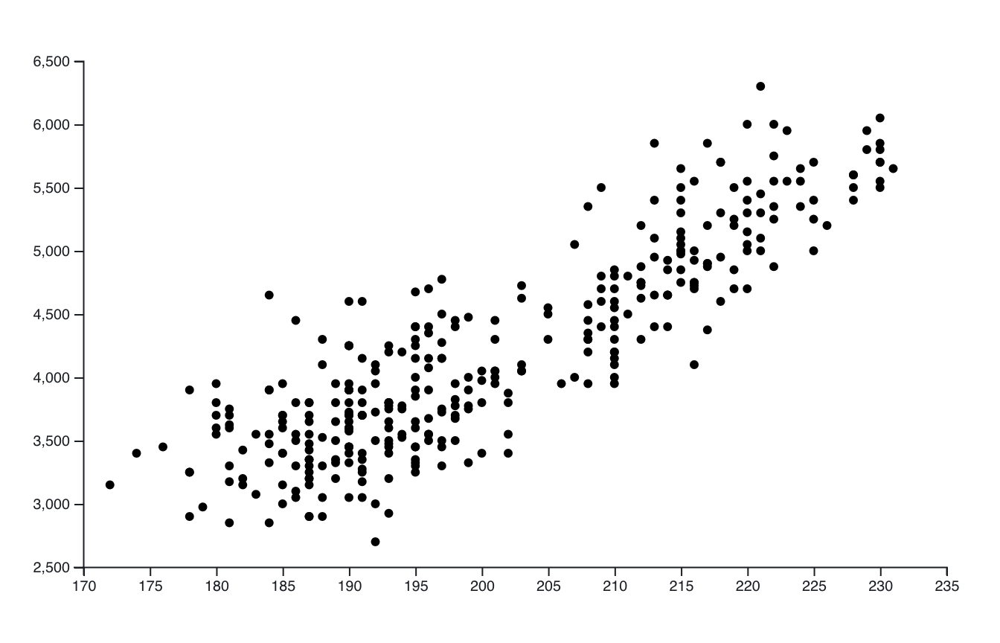
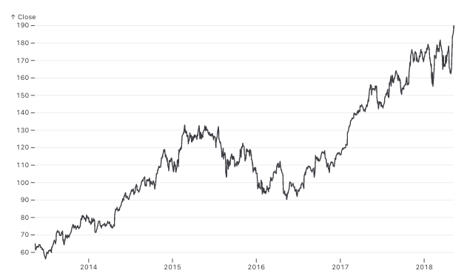
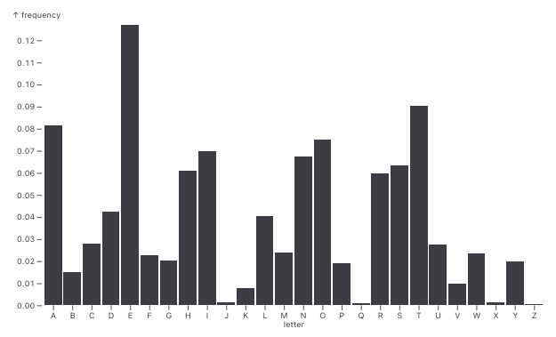
What chart types do you know?
scatterplot
line chart
bar chart
…and probably some others!

Slide 6
But sometimes that’s not quite enough!
unusual
data format
more
aesthetic
complex
multi-variate patterns
highly specific
analysis goals
more
eye-catching

Slide 7
Caveats
can be time-consuming and challenging to implement
can require more effort from users to understand

Slide 8
Custom Visualization Examples

Slide 9
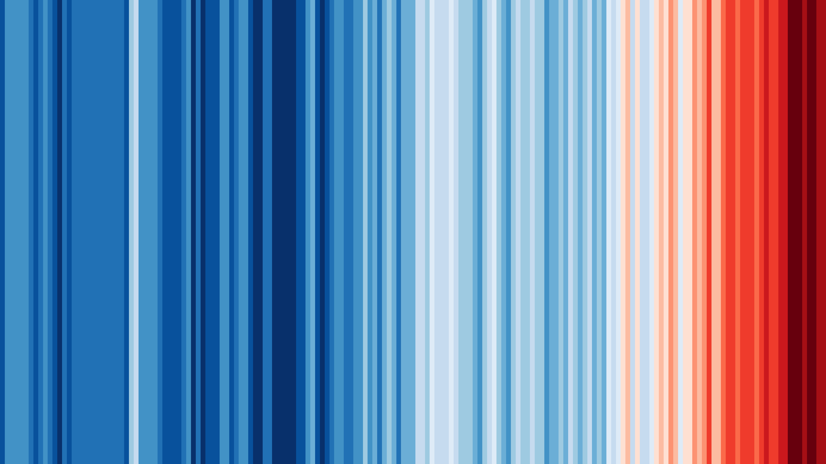
Warming Stripes
Average temperature of each year encoded using color
https://showyourstripes.info/
Created by Ed Hawkins
intuitive to understand for most people
powerful visual
easy to use in different designs
breaks some visualization rules, e.g. lack of axis labels/legend

Slide 10
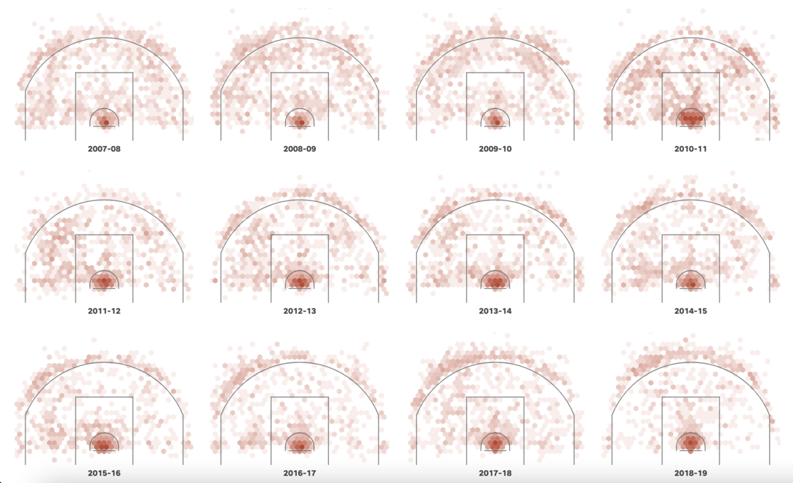
LeBron James has captured the scoring title. We visualized every shot.
By USA Today
https://www.informationisbeautifulawards.com/showcase/6293-lebron-james-has-captured-the-scoring-title-we-visualized-every-shot
unique data with specific spatial information
relatively easy to understand because the lines of the basketball field are shown

Slide 11
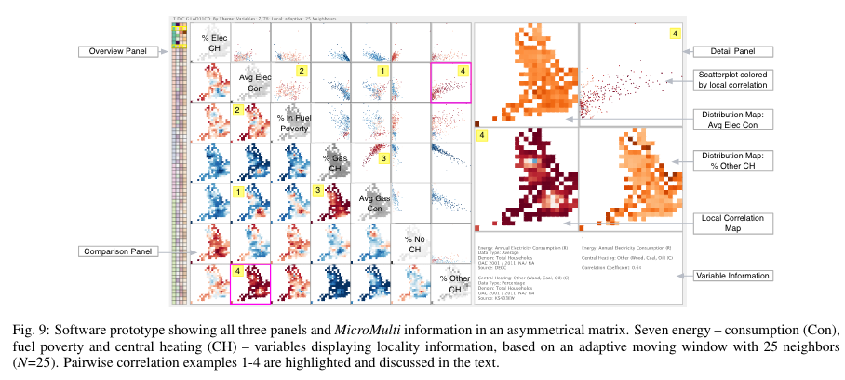
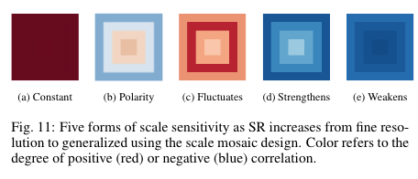
Visualizing Multiple Variables Across Scale and Geography
Goodwin, S., Dykes, J., Slingsby, A. and Turkay, C. (2015). Visualizing Multiple Variables Across Scale and Geography. IEEE Transactions on Visualization and Computer Graphics (Proceedings of the Visual Analytics Science and Technology / Information Visualization / Scientific Visualization 2015), 22(1), pp. 599-608. doi: 10.1109/TVCG.2015.2467199
powerful analysis tool that shows correlations between multiple variables in space, at different scales
challenging to learn how to read patterns – but very powerful when you can

Slide 12
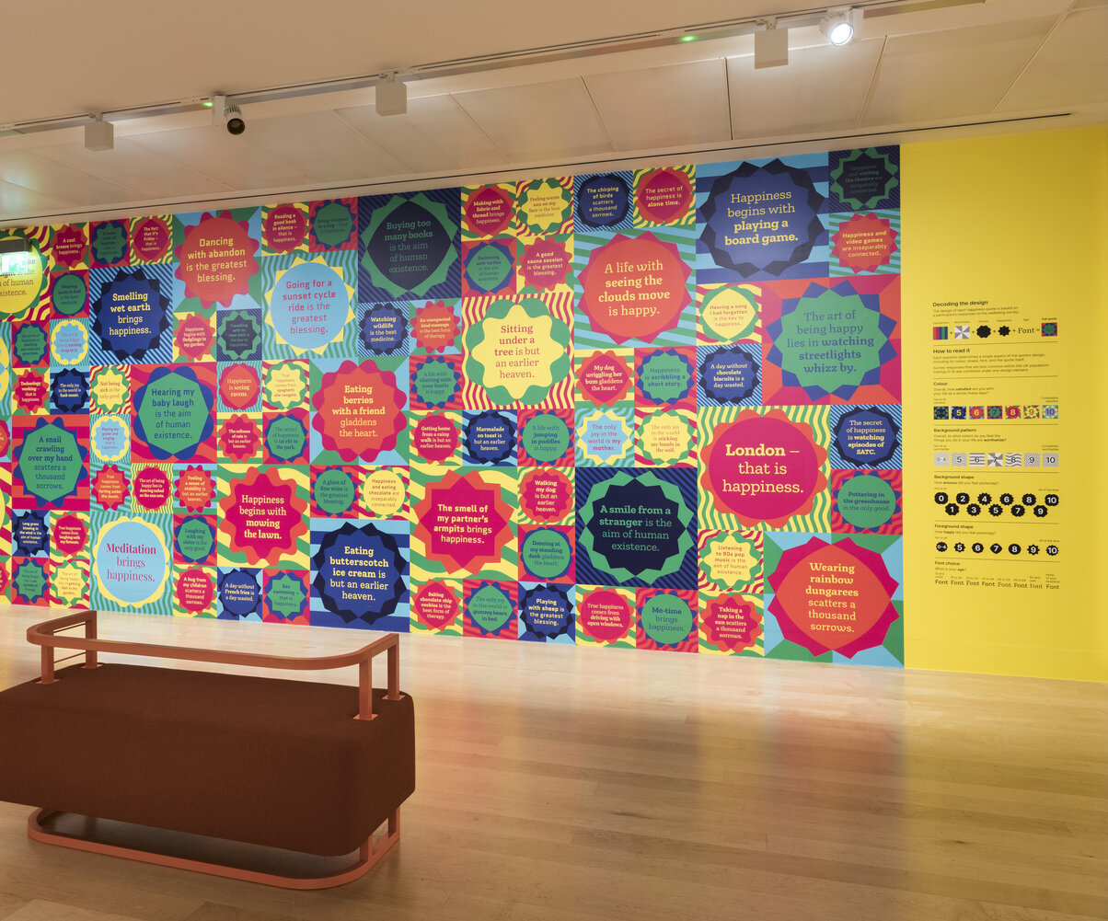
Updating Happiness: Wellcome Collection
by Stefanie Posavec
https://www.stefanieposavec.com/updating-happiness
participative installation where museum visitors filled in a survey and provided quotes on what makes them happy
colors and shapes represent survey responses
possible to read this visualization when given a legend, but this work is less about precise data communication and more about playfulness and drawing attention to the topic

Slide 13
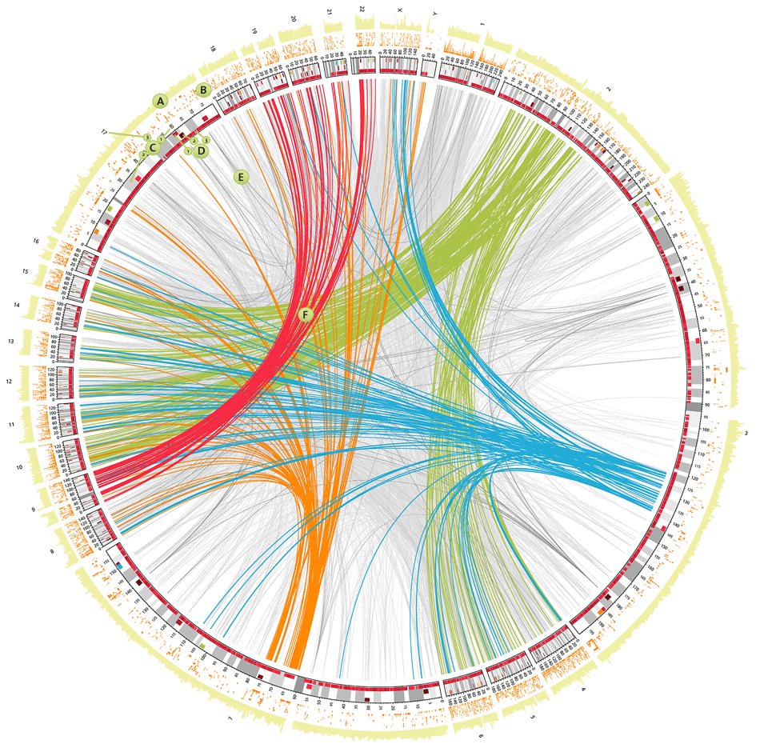
CIRCOS Plots
first introduced in 2009
now commonly used in genomics
https://circos.ca/intro/genomic_data/
complex visualization combining many different encodings
requires training to learn how to read
very powerful when you know how to read it

Slide 14
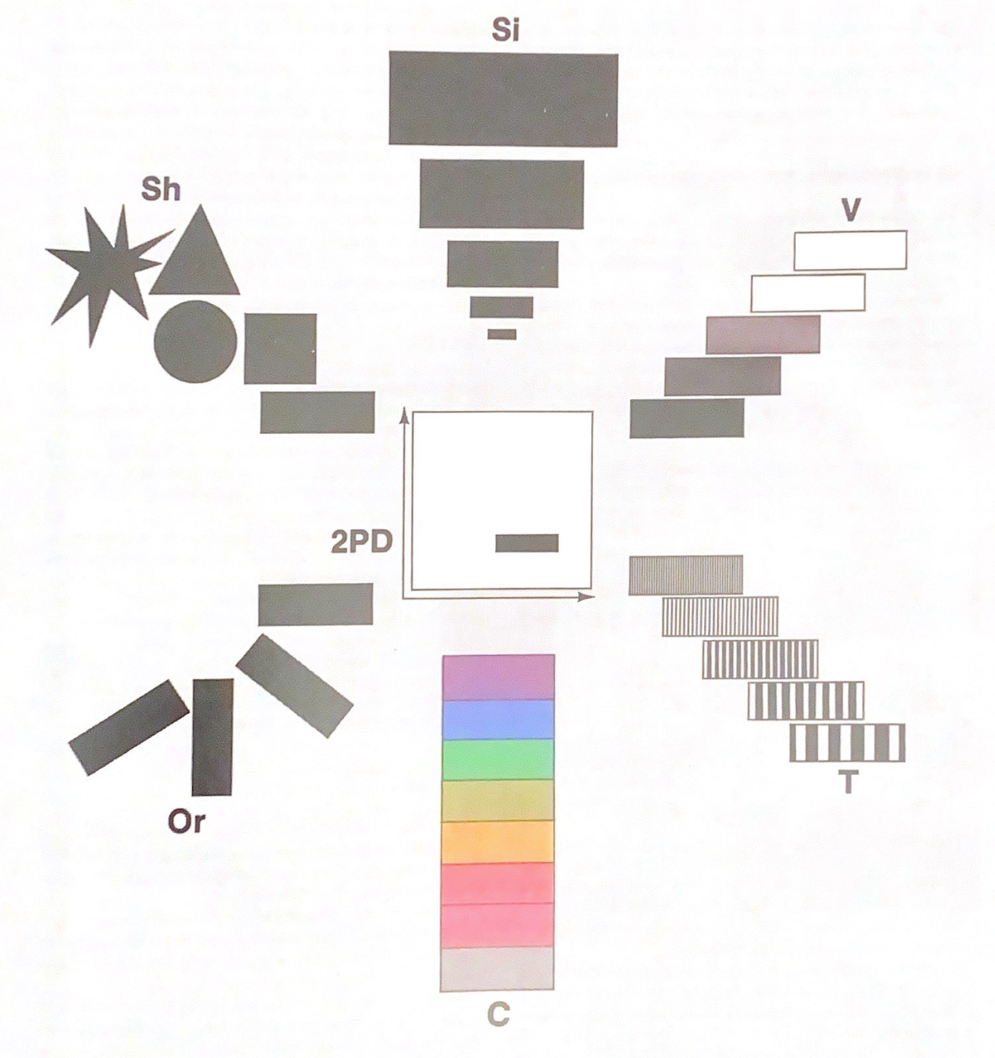
A different way of thinking about visualizations: Visual variables
Jacques Bertin (1918-2010), French cartographer and theorist
Book: Sémiologie Graphique (Semiology of Graphics), 1967

Slide 15
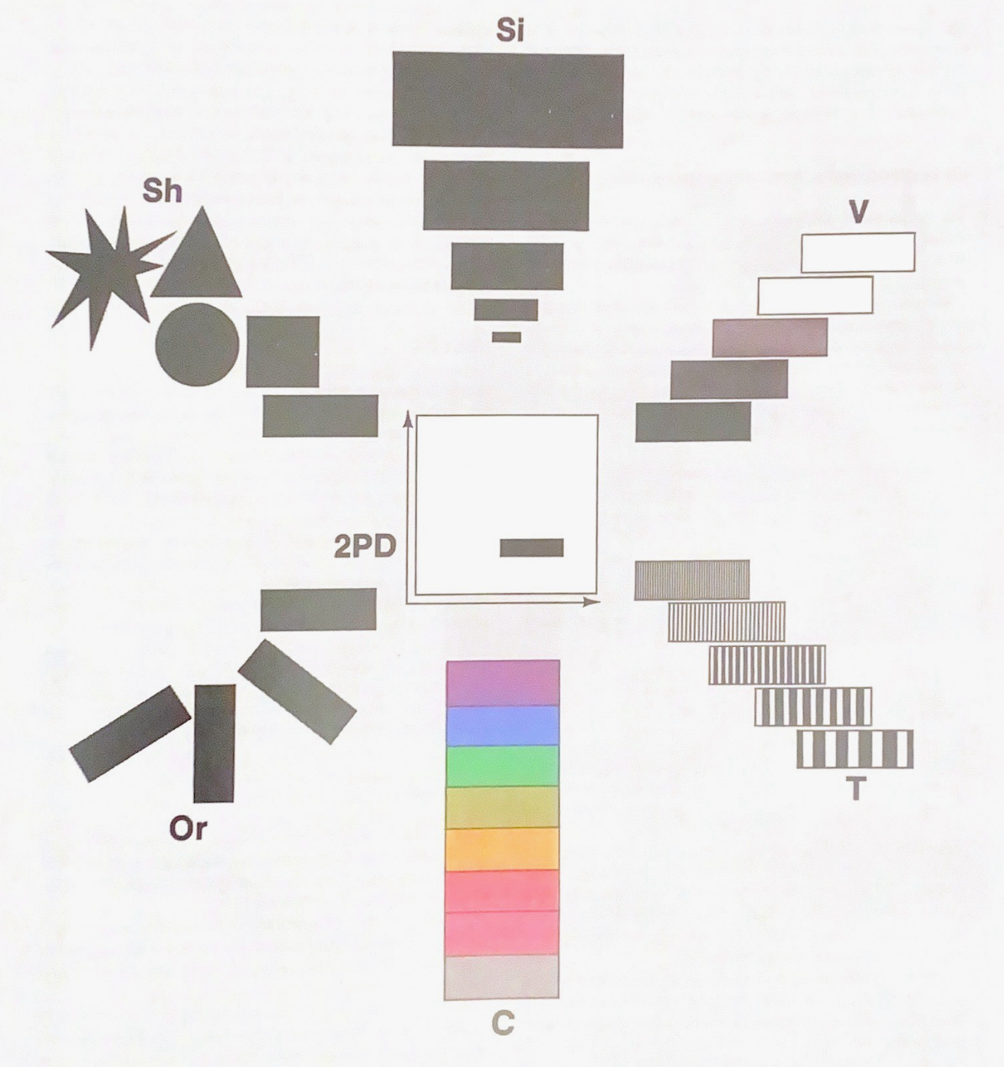
Visual Variables
Size
Shape
Color Value
x/y position
Texture
Size
Color Hue

Slide 16
What visual variables does this visualization use?
x-position to encode the year
color hue + value to encode average temperature
does not use y-position

Slide 17
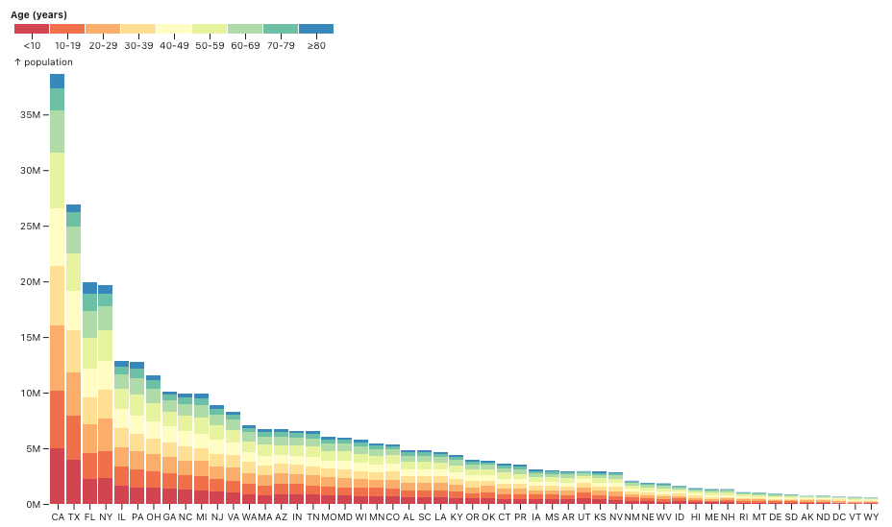
What visual variables does this visualization use?
US Population by state
x-position to encode the state
y-position / size to encode population counts
color hue to encode age groups
https://observablehq.com/@observablehq/plot-stacked-bar-chart

Slide 18
Sketching Exercise
Size
Shape
Color Value
Sketch 3 ideas for custom visualizations using the plastic waste dataset on GitHub
Use as many or as few variables as you like
For each sketch, note which visual variables you are using to encode the different data points
https://github.com/DCS-training/custom-dataviz-observable/
x/y position
Size
Texture
Color Hue

Slide 19
Break

Slide 20
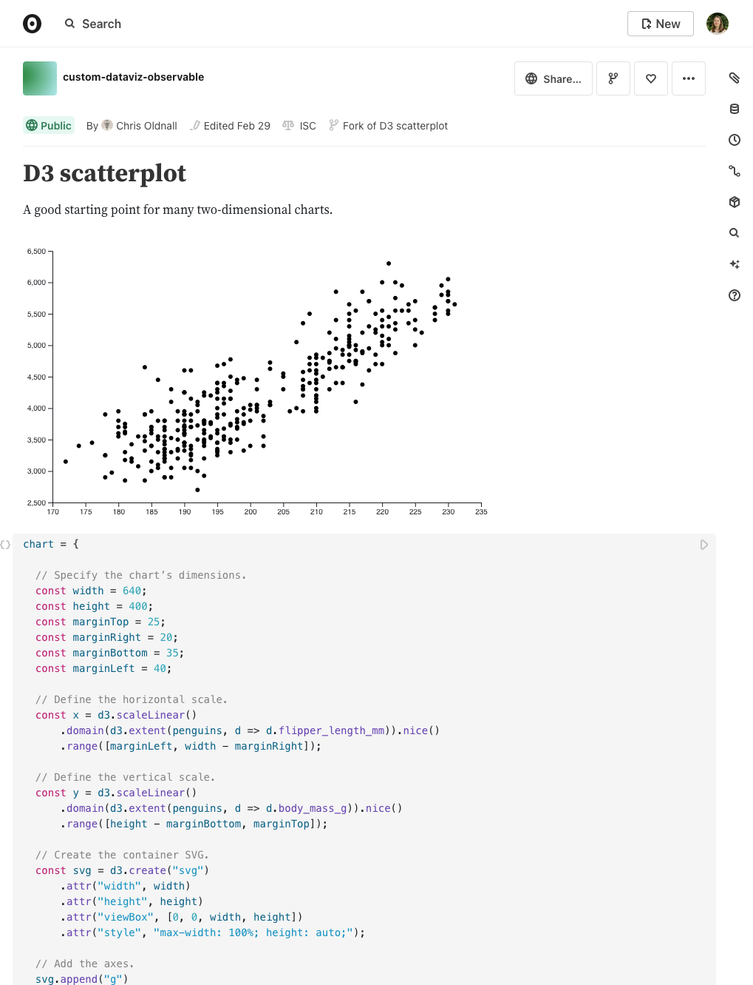
Live Demo: Observable Notebooks & D3
https://observablehq.com/d/f69239b2ac2ff42f

Slide 21
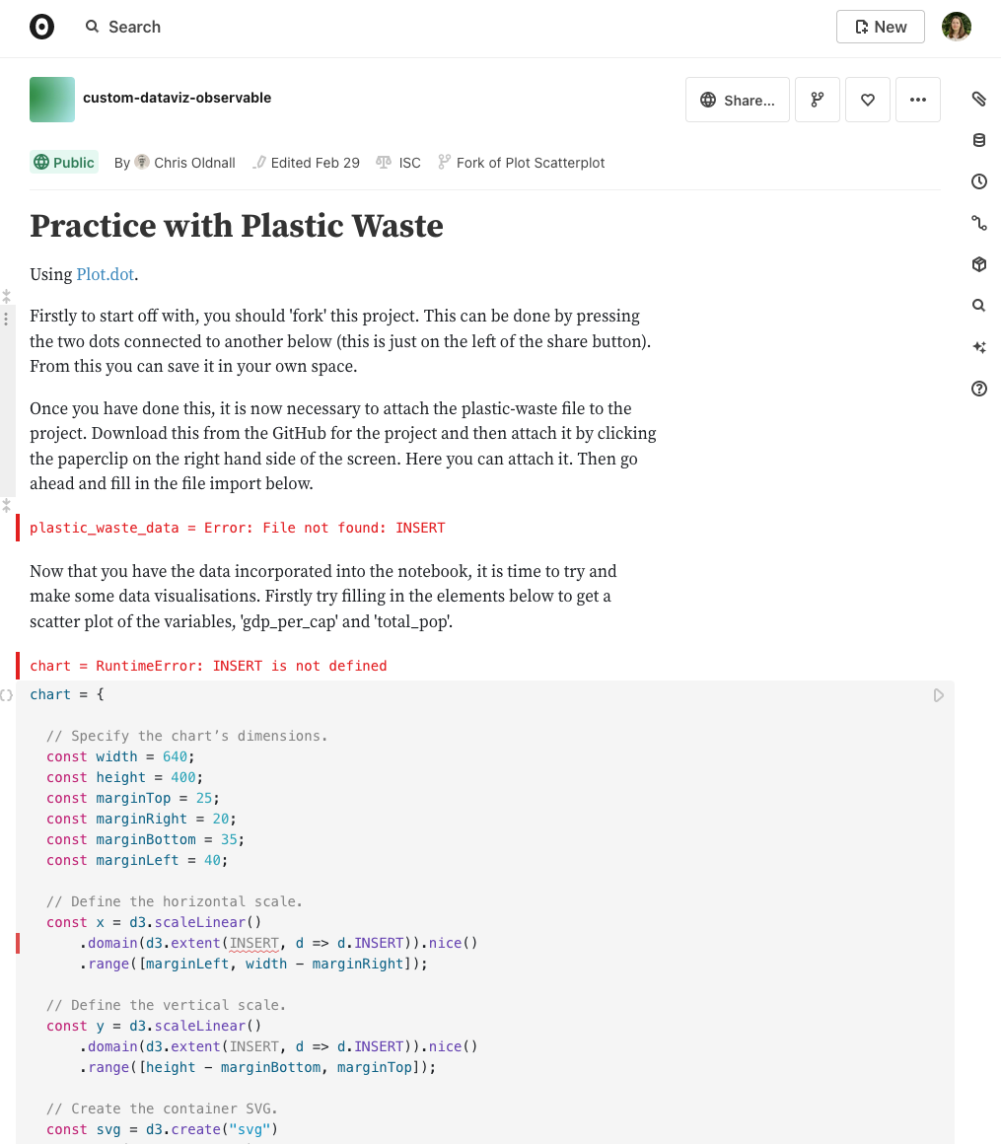
Coding Exercise
Pick one of your ideas from the sketching exercise
Starting from the scatterplot example, try to implement it
Go variable by variable: choose one (visual) variable and implement it, then move on to the next one

Slide 22
Next Week
Open session to work on your custom visualizations
Bring your own data if you like! We will also have sample data for you.
Join the Teams group and ask any questions you have between sessions there!

Slide 23
Schedule for Session 2
Find these slides online:
github.com/DCS-training/ custom-dataviz-observable
13:00 Welcome back & Introduction
13:15 Open session to work on visualizations
13:45 Catch up
13:55 Break
14:05 Open session to work on visualizations
15:00 Wrap up & Closing

Slide 24
Thank you!
Feedback form: see follow-up email
Link to these slides: github.com/DCS-training/ custom-dataviz-observable

